Slide 1

Swayam/NPTEL Courses
For Digital Circuit Course Below is the Link
https://swayam.gov.in/nd1_noc20_ee70/preview
This Course contents are mapped with our DELD syllabus.

Slide 2
The Karnaugh Map
Referred from Slideshare

Slide 3
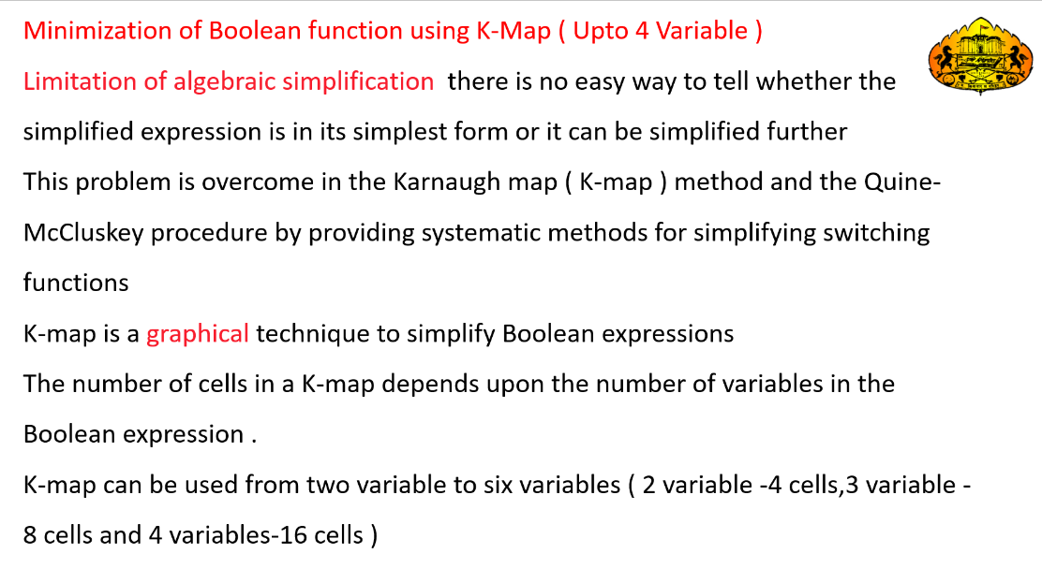

Slide 4
K-map provides a systematic method for simplifying Boolean expressions and, if properly used, will produce the simplest SOP or POS expression possible, known as the minimum expression.

Slide 5
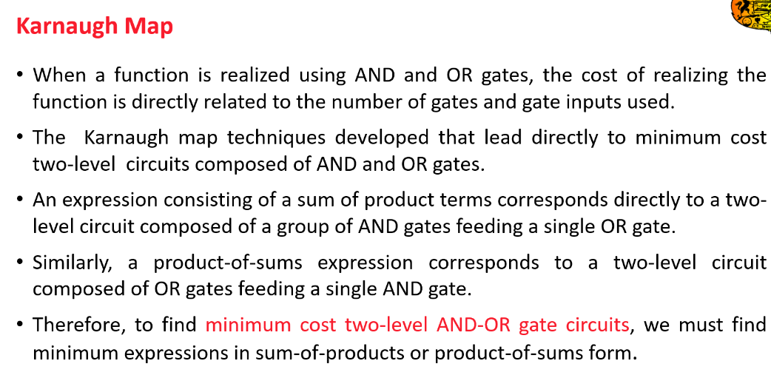

Slide 6
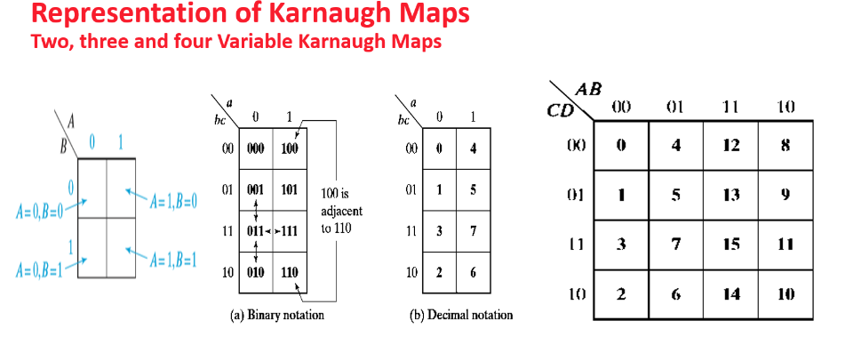

Slide 7
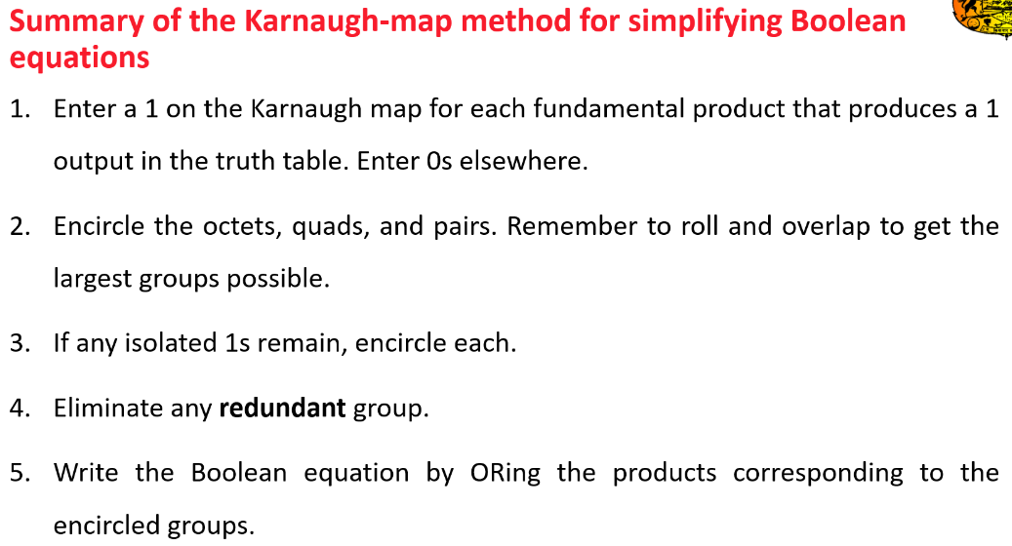

Slide 8
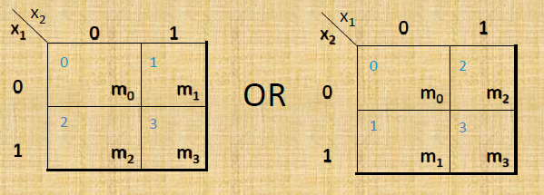
Two-Variable Map
ordering of variables is IMPORTANT for f(x1,x2), x1 is the row, x2 is the column.
Cell 0 represents x1’x2’; Cell 1 represents x1’x2; etc. If a minterm is present in the function, then a 1 is placed in the corresponding cell.

Slide 9
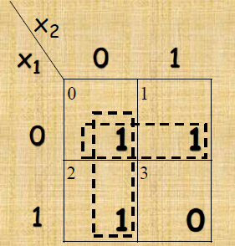
2-Variable Map -- Example
f(x1,x2) = x1’x2’+ x1’x2 + x1x2’
= m0 + m1 + m2
After Simplification
= x1’ + x2’
1s placed in K-map for specified minterms m0, m1, m2
Grouping of 1s allows simplification
What (simpler) function is represented by each
dashed rectangle?
– x1’ = m0 + m1
– x2’ = m0 + m2
Here m0 covered twice

Slide 10
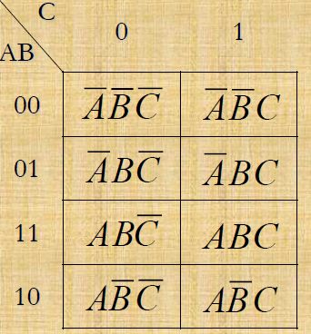
The 3 Variable K-Map
There are 8 cells as shown:
0 | 1
2 | 3
6 | 7
4 | 5

Slide 11
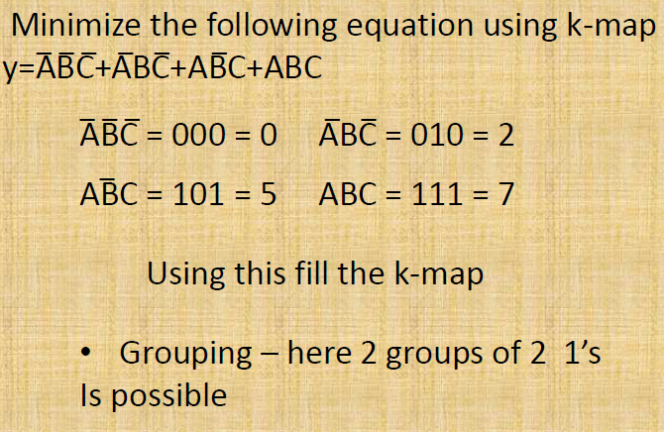
Example 3 variables k-map
Thus output Y is given as

Slide 12
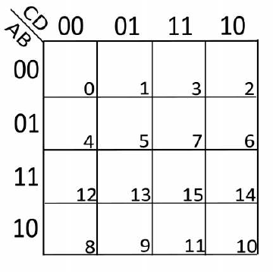
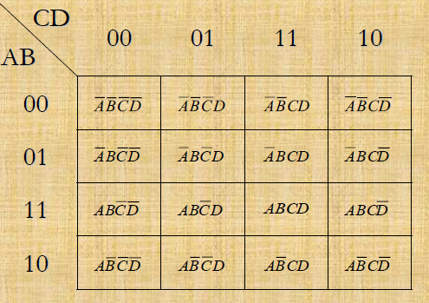
The 4-Variable K-Map

Slide 13
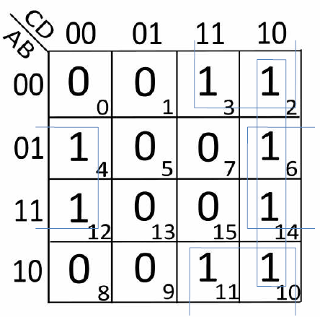
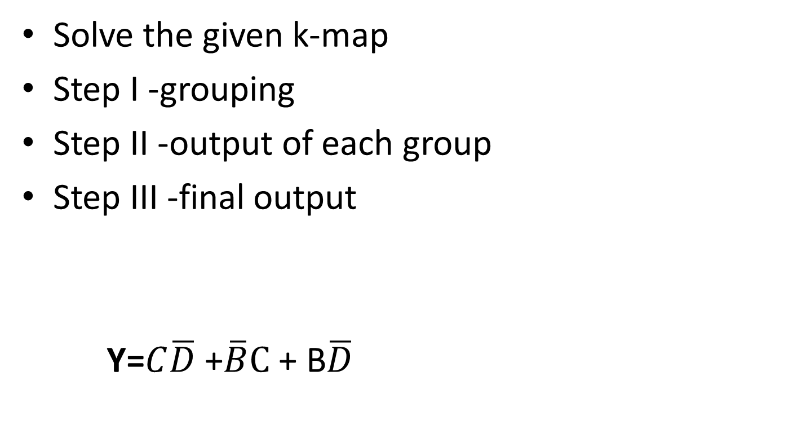
Solve the given k-map
Step I -grouping
Step II -output of each group
Step III -final output
Y=$C\overline{D}$ +$\overline{B}C$+ B$\overline{D}$

Slide 14
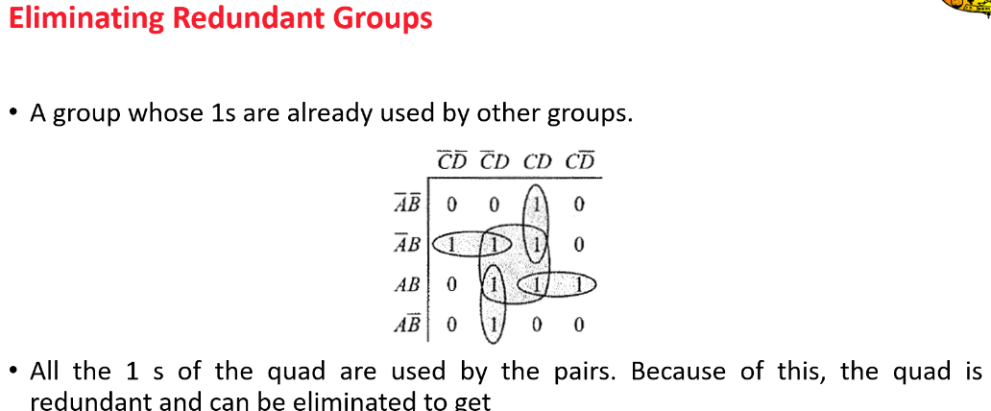

Slide 15
K-Map SOP Minimization
The K-Map is used for simplifying Boolean expressions to their minimal form.
A minimized SOP expression contains the fewest possible terms with fewest possible variables per term.
Generally, a minimum SOP expression can be implemented with fewer logic gates than a standard expression.

Slide 16
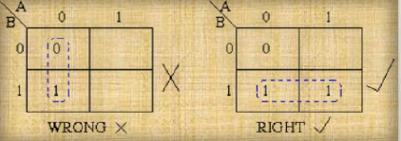
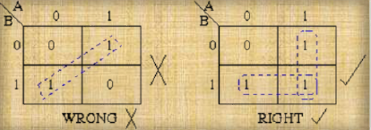
Rules of grouping -
1’s & 0’s can
not be grouped
diagonal 1’s can
not be grouped

Slide 17
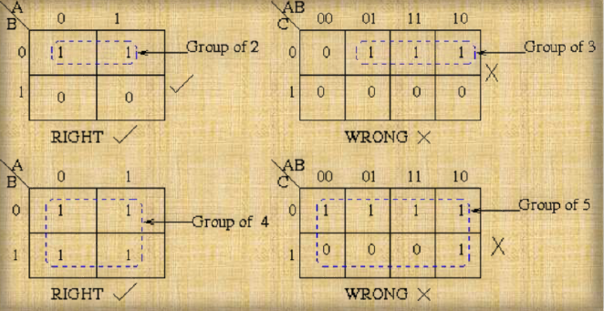
Elements in a group should be 2n

Slide 18
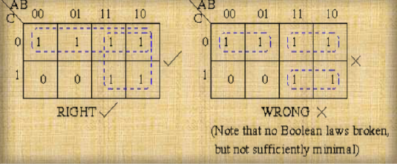
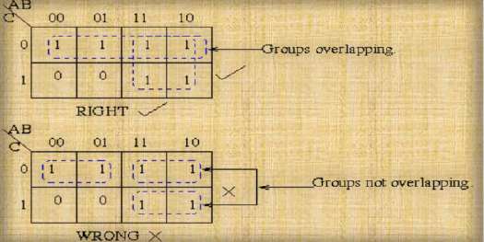
Minimum
Groups
should be
formed
rule group
Overlapping
is applicable

Slide 19
Mapping a Standard SOP Expression
f=∑ (0,4)
f=∑ (0,1,2,3)
f=∑ (0,2,4,6)
f=∑ (13,14)
f=∑ (0,2,8,10)
f=∑ (4,6,12,14)
Notes:
So now I will give u 5 mins to solve these equations

Slide 20

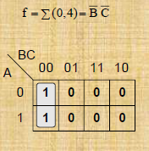
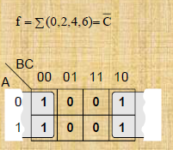
Mapping a Standard SOP Expression
f=∑ (0,1,2,3)
A
B
0 1
1 | 1
1 | 1
0
1
F = 1

Slide 21
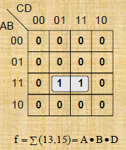
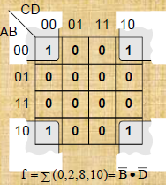
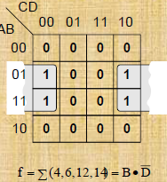

Slide 22
Determining the Minimum SOP Expression from the Map
AB
CD
00 01 11 10
 |  | 1 | 1
1 | 1 | 1 | 1
1 | 1 | 1 | 1
 | 1
00
01
11
10
F = ?

Slide 23
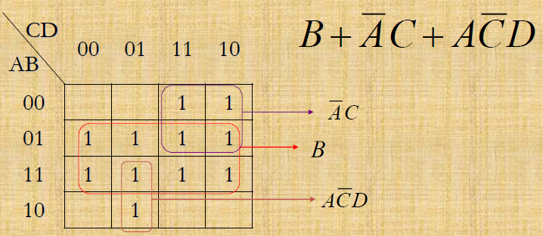
Determining the Minimum SOP Expression from the Map

Slide 24
Determine the Minimum SOP Expression from the Map
AB
C
0 1
1
 | 1
1 | 1
00
01
11
10
F = ?

Slide 25
Determine the Minimum SOP Expression from the Map
AB
C
0 1
1 | 1
1
 | 1
 | 1
00
01
11
10
F = ?

Slide 26
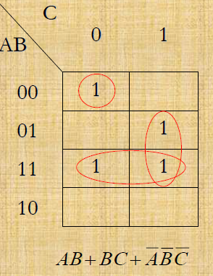
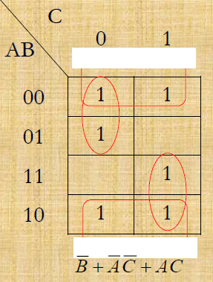
Determining the Minimum SOP Expression from the Map

Slide 27
K-Map POS Minimization
The approaches are much the same (as SOP) except that with
POS expression, 0s representing the standard sum terms are
placed on the K-map instead of 1s.

Slide 28
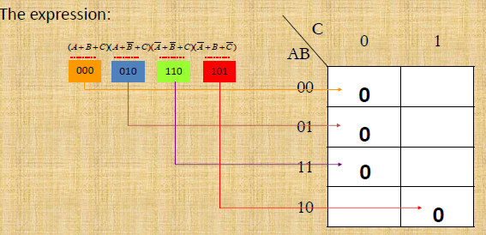
Mapping a Standard POS Expression

Slide 29

K-map Simplification of POS Expression

Slide 30
Design of combinational digital circuits
Steps to design a combinational digital circuit:
– From the problem statement derive the truth table
– From the truth table derive the unsimplified logic expression
– Simplify the logic expression
– From the simplified expression draw the logic circuit

Slide 31
Example: Design a 3-input (A,B,C) digital circuit that will give at its output (X) a logic 1 only if the binary number formed at the input has more ones than zeros.

Slide 32
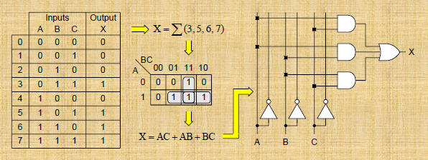

Slide 33
Example: Design a 4-input (A,B,C,D) digital circuit that will give at
its output (X) a logic 1 only if the binary number formed at the input is between 2 and 9 (including).

Slide 34
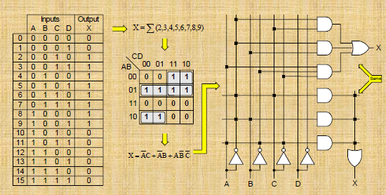

Slide 35
Don’t Care (X) Conditions in K-Maps
The “Don’t Care” conditions allow us to replace the empty cell of a K-Map to form a grouping of the variables.
While forming groups of cells, we can consider a “Don’t Care” cell as either 1 or 0 or we can simply ignore that cell. Therefore, “Don’t Care” condition can help us to form a larger group of cells.
A Don’t Care cell can be represented by a cross(X) in K-Maps representing a invalid combination.

Slide 36
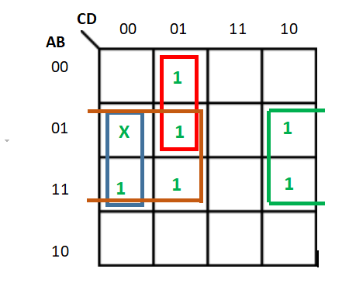
Example-1: Minimise the following function in SOP minimal form using K-Maps:
f = m(1, 5, 6, 12, 13, 14) + d(4)
Therefore, SOP minimal is,
f = BC' + BD' + A'C'D
Refer GeeksforGeeks

Slide 37
Minimise the following function in SOP minimal form using K-Maps:
F(A, B, C, D) = m(0, 1, 2, 3, 4, 5) + d(10, 11, 12, 13, 14, 15)
Example-2:

Slide 38
Example-3: Minimise the following function in SOP minimal form using K-Maps: F(A, B, C, D) = m(1, 2, 6, 7, 8, 13, 14, 15) + d(3, 5, 12)
Therefore,
f = AC'D' + A'D + A'C + AB

Slide 39
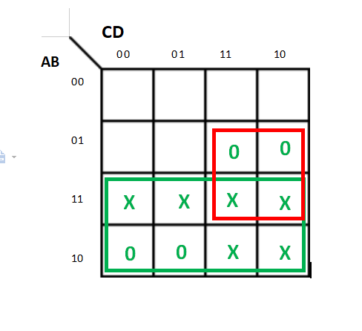
Writing the given expression in POS form:
F(A, B, C, D) = M(6, 7, 8, 9) + d(10, 11, 12, 13, 14, 15)
Therefore, POS minimal is,
F = A'(B' + C')

